Slide 1
Boosting Algorithms: AdaBoost, Stochastic Gradient Boosting, Voting Ensemble. Self Learning Topic:- AdaBoost as a Forward Stage wise Additive Model
Practical 8

Slide 2
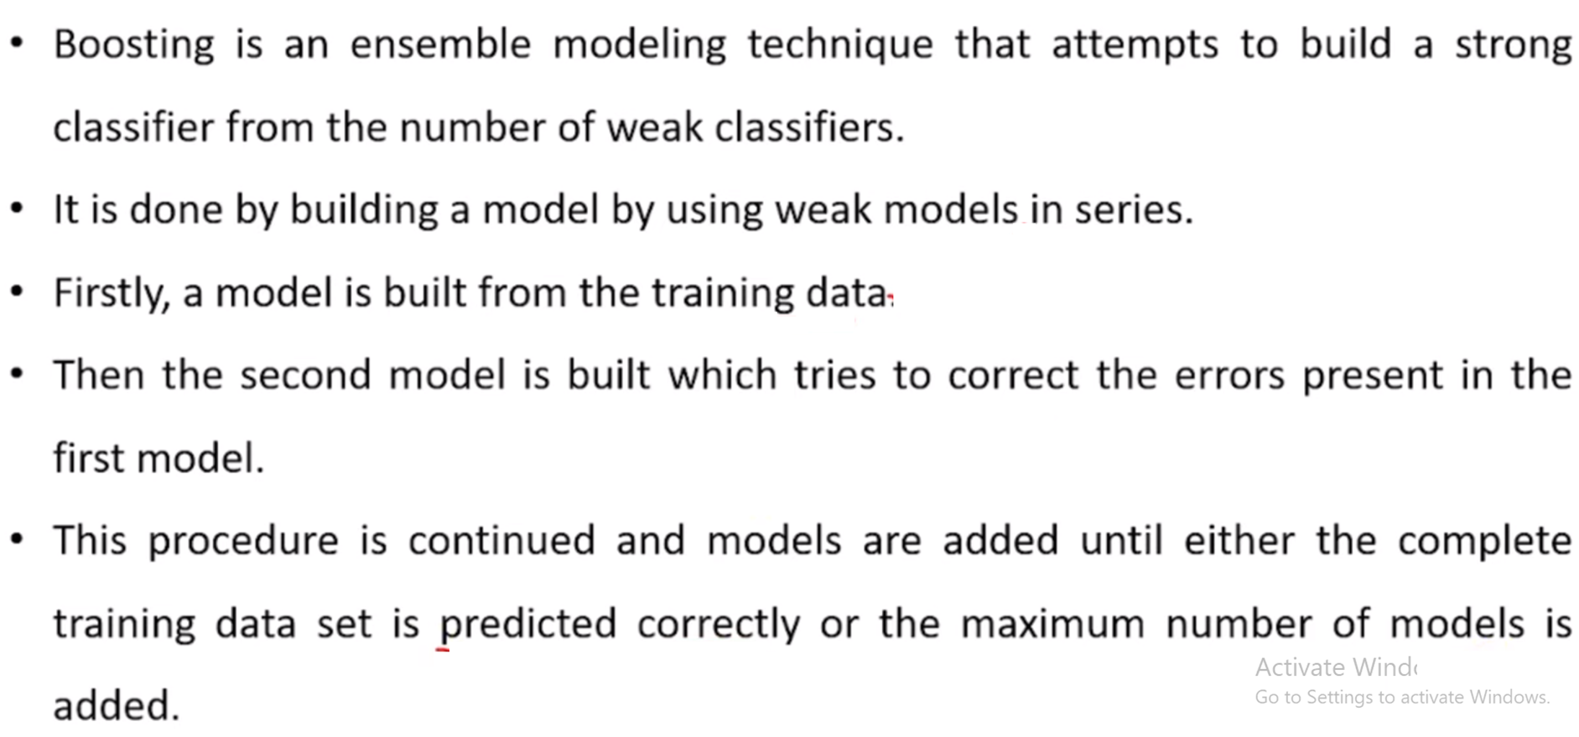
Boosting

Slide 3
Boosting Algorithm Example
Let’s understand this with an example of the email, which recognize whether the email, is a spam or not? It can be recognized it by the following conditions:
Spam:
If an email contains lots of source like that means it is spam.
If an email contains only one file image, then it is spam.
If an email contains the message of “You Own a lottery of $xxxxx”, that means it is spam.
Not Spam:
If an email contains some known source, then it is not spam.
If it contains the official domain like educba.com, etc., that means it is not spam.
The above-mentioned rules are not that powerful to recognize the spam or not; hence these rules are called as weak learners.
To convert weak learner to strong learner, combine the prediction of the weak learner using the following methods.
Using weighted average.
Consider prediction has a higher vote.
Consider the above 5 rules; there are 3 votes for spam and 2 votes for not spam. As there is high vote for spam, we consider it as spam.

Slide 4
How Boosting algorithm works
To choose the right distributions follow the steps as specified:
Step 1: The base Learning algorithm combines each distribution and applies equal weight to each distribution.
Step 2: If any prediction occurs during the first base learning algorithm, then we pay high attention to that prediction error.
Step 3: Repeat step 2 until the limit of the Base Learning algorithm has been reached or high accuracy.
Step 4: Combines the entire weak learner to create one strong prediction rule.

Slide 5
TYPES OF BOOSTING ALGORITHM
1. AdaBoost (Adaptive Boosting) algorithm
2. Gradient Boosting algorithm
3. XG Boost algorithm
4. Voting Ensemble

Slide 6
AdaBoost
AdaBoost or Adaptive Boosting is an instance-based supervised learning technique, which means that instead of creating a separate ML model for each new observation, AdaBoost creates multiple base models during training and uses them to make predictions about new observations.
This algorithm was designed for classification problems but has been extended to regression problems as well.
Here, we are going to focus on the classification side of the technique.
AdaBoost improves the generalization capabilities of the multiple models it combines and simplifies their maintenance.

Slide 7
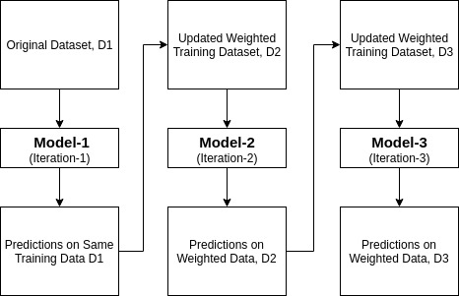
How AdaBoost Works?
It works in the following steps:
Initially, Adaboost selects a training subset randomly.
It iteratively trains the AdaBoost machine learning model by selecting the training set based on the accurate prediction of the last training.
It assigns the higher weight to wrong classified observations so that in the next iteration these observations will get the high probability for classification.
Also, It assigns the weight to the trained classifier in each iteration according to the accuracy of the classifier. The more accurate classifier will get high weight.
This process iterate until the complete training data fits without any error or until reached to the specified maximum number of estimators.
To classify, perform a "vote" across all of the learning algorithms you built.

Slide 8
What is AdaBoost Algorithm Used for?
AdaBoost can be used for face detection as it appears to be the standard algorithm for face detection in images. It employs a rejection cascade comprising of numerous layers of classifiers. As the detection window is not recognized at any layer as a face, it gets rejected. The first classifier in the window discards the negative window keeping the computational cost to the least. Even if AdaBoost combines the weak classifiers, the principles of AdaBoost are utilized to find the best features to utilize in each layer of the cascade.
Pros and Cons:
Pros: AdaBoost Algorithm is it is fast, simple and easy to program. It has the flexibility to be combined with any machine learning algorithm, and doesn’t need to tune the parameters except for T. It has been extended to learning problems beyond binary classification, and it is versatile as it can be used with text or numeric data.
Cons: Weak classifiers being too weak can lead to low margins and overfitting.

Slide 9
Pseudocode of AdaBoost
Initially set uniform example weights.
for Each base learner do:
Train base learner with a weighted sample.
Test base learner on all data.
Set learner weight with a weighted error.
Set example weights based on ensemble predictions.
end for
https://analyticsindiamag.com/introduction-to-boosting-implementing-adaboost-in-python/
https://www.analyticsvidhya.com/blog/2021/03/introduction-to-adaboost-algorithm-with-python/

Slide 10
Example AdaBoost in Python
Refer Adaboost ApplesOranges file to see how AdaBoost is applied for apples and oranges data

Slide 11
Exercise 1
Apply AdaBoosting algorithm for Social_Network_Ads data

Slide 12
FAQ
1. What does AdaBoost do?
AdaBoost combines multiple weak classifiers to create a strong classifier, with higher weights assigned to misclassified data in each iteration, boosting their significance in the final model.
2. What is the difference between gradient boosting and Ada boosting?
Gradient boosting algorithms and AdaBoost differ in their approach to iteratively improve models. While AdaBoost adjusts weights for misclassified points, gradient boosting focuses on minimizing errors using gradients of loss functions.
3. What is an example of boosting?
Boosting algorithms like AdaBoost, sequentially combine weak learners (e.g., decision trees) to create a robust model by giving more weight to misclassified data in each iteration.
4. What is the AdaBoost classifier algorithm?
AdaBoost classifier algorithm builds a strong classifier by combining multiple weak learners, assigning higher weight to misclassified data points iteratively, achieving high accuracy in classification tasks.

Slide 13
GRADIENT BOOSTING ALGORITHM
Gradient boosting algorithm is a machine learning technique used to define loss function and reduce it [4,7,8]. It is also used to solve problems of classification using various prediction models involving the following steps:
1. Loss Function:
The use of the loss function depends on the type of problem. The advantage of gradient boosting is that there is no need for a new boosting algorithm for each loss function [4,7,8].
2. Weak Learner:
In gradient boosting, decision trees are used as a weak learner. A regression tree is used to give true values, which can be combined together to create correct predictions. Like in the AdaBoost algorithm, small trees with a single split are used, i.e. decision stump. Larger trees are used for large levels I,e 4-8 levels [4,7,8].
3. Additive Model:
In this model, trees are added one at a time. existing trees remains the same. During the addition of trees, gradient descent is used to minimize the loss function.
The Gradient Boosting Machine is a powerful ensemble machine learning algorithm that uses decision trees.
Gradient boosting is a generalization of AdaBoosting, improving the performance of the approach and introducing ideas from bootstrap aggregation to further improve the models, such as randomly sampling the samples and features when fitting ensemble members.
Gradient boosting performs well, if not the best, on a wide range of tabular datasets, and versions of the algorithm like XGBoost and LightBoost often play an important role in winning machine learning competitions [4,7,8].
Gradient Boosting ensemble is an ensemble created from decision trees added sequentially to the model.

Slide 14
GRADIENT BOOSTING MACHINES ALGORITHM
Gradient boosting refers to a class of ensemble machine learning algorithms that can be used for classification or regression predictive modeling problems.
Gradient boosting is also known as gradient tree boosting, stochastic gradient boosting, and gradient boosting machines. Models are fit using any arbitrary differentiable loss function and gradient descent optimization algorithm. This gives the technique its name, “gradient boosting,” as the loss gradient is minimized as the model is fit, much like a neural network.
Gradient boosting works by building weak prediction models sequentially where each model tries to predict the error left over by the previous model. Because of this, the algorithm tends to over-fit rather quick.

Slide 15
Example Stochastic GRADIENT BOOSTING Python
Refer Gradient Boosting ApplesOranges file to get an idea of how Gradient Boosting is done for apples_and_oranges data

Slide 16
Exercise 2
Apply Gradient Boosting for Social_Network_Ads data

Slide 17
Improving performance of gradient boosted decision trees
Gradient boosting algorithms are prone to overfitting and consequently poor perfomance on test dataset. There are some pointers you can keep in mind to improve the perfomance of gradient boosting algorithm.
Stochastic Gradient Boosting: Stochastic gradient boosting involves sub sampling the training dataset and training individual learners on random samples created by this sub sampling. This reduces the correlation between results from individual learners and combining results with low correlation provides us with a better overall result.
Shrinkage: The predictions of each tree are added together sequentially. Instead, the contribution of each tree to this sum can be weighted to slow down the learning by the algorithm. This weighting is called a shrinkage or a learning rate. Using a low learning rate can dramatically improve the perfomance of your gradient boosting model. Usually a learning rate in the range of 0.1 to 0.3 gives the best results.
Regularization: L1 and L2 regularization penalties can be implemented on leaf weight values to slow down learning and prevent over-fitting. Gradient tree boosting implementations often also use regularization by limiting the minimum number of observations in trees’ terminal nodes.
Tree Constraints: There are a number of ways in which a tree can be constrained to improve performance.
Number of trees
Tree depth
Minimum improvement in loss
Number of observations per split

Slide 18
Voting ensemble
A voting ensemble (or a “majority voting ensemble“) is an ensemble machine learning model that combines the predictions from multiple other models.
It is a technique that may be used to improve model performance, ideally achieving better performance than any single model used in the ensemble.
A voting ensemble works by combining the predictions from multiple models. It can be used for classification or regression. In the case of regression, this involves calculating the average of the predictions from the models. In the case of classification, the predictions for each label are summed and the label with the majority vote is predicted.
Regression Voting Ensemble: Predictions are the average of contributing models.
Classification Voting Ensemble: Predictions are the majority vote of contributing models.
There are two approaches to the majority vote prediction for classification; they are hard voting and soft voting.
Hard voting involves summing the predictions for each class label and predicting the class label with the most votes. Soft voting involves summing the predicted probabilities (or probability-like scores) for each class label and predicting the class label with the largest probability.
Hard Voting: Predict the class with the largest sum of votes from models
Soft Voting: Predict the class with the largest summed probability from models.

Slide 19
Voting ensemble (Contd.)
A voting ensemble may be considered a meta-model, a model of models.
As a meta-model, it could be used with any collection of existing trained machine learning models and the existing models do not need to be aware that they are being used in the ensemble. This means you could explore using a voting ensemble on any set or subset of fit models for your predictive modeling task.
A voting ensemble is appropriate when you have two or more models that perform well on a predictive modeling task. The models used in the ensemble must mostly agree with their predictions.

Slide 20
Use voting ensembles when
All models in the ensemble have generally the same good performance.
All models in the ensemble mostly already agree.
Hard voting is appropriate when the models used in the voting ensemble predict crisp class labels. Soft voting is appropriate when the models used in the voting ensemble predict the probability of class membership. Soft voting can be used for models that do not natively predict a class membership probability, although may require calibration of their probability-like scores prior to being used in the ensemble (e.g. support vector machine, k-nearest neighbors, and decision trees).
Hard voting is for models that predict class labels.
Soft voting is for models that predict class membership probabilities.
The voting ensemble is not guaranteed to provide better performance than any single model used in the ensemble. If any given model used in the ensemble performs better than the voting ensemble, that model should probably be used instead of the voting ensemble.
This is not always the case. A voting ensemble can offer lower variance in the predictions made over individual models. This can be seen in a lower variance in prediction error for regression tasks. This can also be seen in a lower variance in accuracy for classification tasks. This lower variance may result in a lower mean performance of the ensemble, which might be desirable given the higher stability or confidence of the model.

Slide 21
Use a voting ensemble if
It results in better performance than any model used in the ensemble.
It results in a lower variance than any model used in the ensemble.
A voting ensemble is particularly useful for machine learning models that use a stochastic learning algorithm and result in a different final model each time it is trained on the same dataset. One example is neural networks that are fit using stochastic gradient descent.
Another particularly useful case for voting ensembles is when combining multiple fits of the same machine learning algorithm with slightly different hyperparameters.

Slide 22
Voting ensembles are most effective when
Combining multiple fits of a model trained using stochastic learning algorithms.
Combining multiple fits of a model with different hyperparameters.
A limitation of the voting ensemble is that it treats all models the same, meaning all models contribute equally to the prediction. This is a problem if some models are good in some situations and poor in others.
An extension to the voting ensemble to address this problem is to use a weighted average or weighted voting of the contributing models. This is sometimes called blending. A further extension is to use a machine learning model to learn when and how much to trust each model when making predictions. This is referred to as stacked generalization, or stacking for short.
Extensions to voting ensembles:
Weighted Average Ensemble (blending).
Stacked Generalization (stacking).

Slide 23
Example Voting Emsemble using Python
Refer VotingEnsemble ApplesOranges file to get an idea of how Voting Ensemble is done for apples_and_oranges data

Slide 24
Exercise 3
Apply Voting Ensemble for Social_Network_Ads data

